Slide 1
Collision Resolution in 2D
TexPoint fonts used in EMF.
Read the TexPoint manual before you delete this box.: AAAAAAAAAA

Slide 2
Simple Collisions

Slide 3
Simple Collision
Given:
Notes:
r represents positions.
We are given the positions of Body A and B’s center of masses in world space (r_A and r_B). And the position of the contact point in world space (r_P).
omega A and B are the angular velocity scalars for either body.
v_A and v_B are the linear velocities of either body
M_A M_B are the masses of either body
I_A, I_B are the scalar moments of inertia for either body (angular analog of mass)

Slide 4
Simple Collision
Calculate:
Notes:
Calculate r_AP: position of point P in Body A’s local space (centered at center of mass).
Likewise Body B
Calculate v_AP: instantaneous velocity of r_AP given Body A’s linear and angular velocity.
Again, likewise Body B.
The motion induced by spinning is always perpendicular to the lever arm
Which is why we use the vector perpindicular to r_AP and r_BP

Slide 5
Coefficient of Restitution
Notes:
Delta v is the relative velocity at point P between either body.
Delta v_f is the final relative velocity after the collision, which is what we’re trying to find.
Delta v_i is the initial relative velocity, which we can calculate from our givens.
The coefficient of restitution (e) is the negative ratio of the final and initial velocities along the contact normal
e = 0 is a perfectly inelastic collision. The two objects stick together
e = 1 is a perfectly elastic collision. The two objects bounce apart without loss of energy
------
What we’re really interested in is the change in relative velocities at point P. Define lower case delta v as that change.
Start with the definition for the coefficient of restitution.
Multiply out the denominator
Substitute in our equation we defined *in the lower left column*
Distribute the dot product
Move the initial velocity term to the right hand side
Group our Delta v_i terms together.
Let the user supply e at the start of the collision.
Our entire right hand side is known at the start of the collision.
We just need to somehow solve for lowercase delta v.

Slide 6
Resistance Term
Notes:
To that end:
Suppose we define a resistance term capital Omega (think the symbol for Ohms in electronics).
(This resistance term is really an inverse resistance term.)
(Infinite resistance to motion would be represented as 0.)
The resistance to move two bodies apart at point P is the sum of their individual resistances to motion at point P.
The resistance term for body X is the sum of its resistance to linear forces and its resistance to angular torques.
“a_x” represents the linear resistance term for body x.
“q_x” represents the angular resistance term for body x.
,
Here the cross product produces a scalar quantity. Also called the “perp dot” product.
These terms are described by Chris Hecker in his article “Physics, Part 3: Collision Response”
But not called or labeled like this.

Slide 7
Impulse
Notes:
Back to our “delta v dot n” term.
Let’s assume that the change in relative velocity is parallel to the collision normal.
We also assume that the change in relative velocity happens instantaneously.
This is called: “Newton’s Law of Restitution for Instantaneous Collisions with No Friction.”
We can now express delta v in terms of an unknown scalar impulse term j and our known resistance term Omega.
-----
Substituting our terms for “delta v dot n”, we can now solve for our scalar impulse term j.
The only danger is when Omega is 0 or infinite,
Which should only happen when you have bodies with 0 or infinite mass.
------

Slide 8
Impulse
Notes:
The actual impulse vector will be “j times n”.
The impusle vector gives our change in momentum,
which we can then translate into changes in linear and angular velocity.
From the known changes in quantities, we can easily find the final linear and angular velocities of our bodies.
These equations are also described in “Physics, Part 3: Collision Response” by Chris Hecker in a slightly different form

Slide 9
Multiple Simultaneous Collisions
Notes:
Let’s generalize our work for single equations for the case of multiple simultaneous collisions.

Slide 10
Multiple Collisions
Notes:
Examine the diagram given.
Three bodies are in direct or indirect contact.
They form a “collision island”
The “island” is a essentially a system of equations.
Suppose we are given the same information per collision here that we were for the single equation we examined before.
Our goal is to take this information and manipulate it into a familiar form Ax = b, where A is a matrix and x and b are column matrices (vectors).
---
Important to note: there can be more than one collision point per pair of bodies.
For the case of an edge on edge collision,
As shown with Body B and C.
,
Vertices at the extremes of the contact segment are discrete contact points.
Beyond recognizing that we can describe an edge to edge collision as two discrete vertex to edge collisions,
No special action needs to be taken.

Slide 11
Multiple Collisions
Notes:
Recall our equations for finding the change in linear and angular velocities given the scalar impulse term.
For multiple collisions, multiple impulse terms exist,
So multiple delta V and delta omega terms exist.

Slide 12
Multiple Collisions
Notes:
Sum all the individual delta terms from k – 1 to c collisions.
We can thus find the aggregate delta terms.
We can treat the individual terms in isolation
As long as the scalar impulse terms are found correctly.
,
Note:
The delta terms can be 0 for both bodies
f neither body is involved in a particular collision k

Slide 13
Multiple Collisions
Notes:
Do some more algebra:
Take our original definition of delta v, and solve for delta v.
Then substitute in our definitions of delta v f and delta v i.
Group the B terms together and the A terms together.
Name the new groupings Delta V b p and Delta V a p
,
Which represent the change in velocities of either body at point P.

Slide 14
Multiple Collisions
Notes:
Take again our single collision equation.
By substituting in the our new definition of delta v
And distributing the dot n
We have a new task:
,
Find the change in velocities at point P for either body along the collision normal.
The usefulness of this will become clear later.

Slide 15
Multiple Collisions
Notes:
Take again our definition for the velocity of point P on body x.
0. The change in the velocity of Point P on body x
1. Substitute in the definitions for multiple collisions we derived
Substitute the individual delta terms with their definitions.
The summation terms are identical, so combine them into a single term
And group the impulse terms j_k together.

Slide 16
Multiple Collisions
Notes:
Now dot both sides with n:
This allows us to make the sum a scalar product instead of a vector.
So we place the n collision normal inside the sum.
2. We can now distribute the collision normal
And group terms according to mass or moment of inertia.
These terms should look familiar…

Slide 17
Multiple Collisions
Notes:
Remember our definition of a resistance term for a simple collision.
For each collision l, we can create a simple equation to describe it.
First,
We can define similar resistance terms for multiple collisions as we did for single collisions,
But with one resistance term per collision k
If k == l, we get the same “a” and “q” terms we did for a single collision.
---
We now have defined a linear transformation of scalar impulse terms
To repesent the change in velocity of point P on body x.

Slide 18
Multiple Collisions
Notes:
Set b_l equal to the “known” right hand side for collision l
We now have all the pieces to describe the lth collision.
Substitute in the definition for delta v.
Then substitute in the definition for delta v xP l
Remembering the “equal but opposite” rule for the second body’s equation (negative j_k term).
We can then combine the summation terms together, and group the j_k terms.
This equation entirely describes the lth collision in terms of the unknown quantities j_k

Slide 19
Multiple Collisions
Notes:
Combine each body’s resistance terms into a single resistance term “Omega k l”,
For the two bodies involved in the lth collision.
Which body is designated A and which is B doesn’t matter.
We can now define a matrix of resistance coefficients (A),
and our known initial conditions vector (b)
And our unknown vector of impulse terms j_k.
----
Now we have Aj = b. We just need to solve for j.

Slide 20
Multiple Collisions
Solving with LU decomposition
Notes:
The usual method for solving Aj = b is to
Decompose A into a lower triangular matrix L
And an upper triangular matrix U.
This process is O(c^3) in the general case.
------
We can now solve for j using forward and backward substitution in O(c^2) time.
,
We can even change the initial configuration of velocities and resolve in O(c^2) time.
----
We can also add new bodies to the island in O(c^2) time.
f is the new column (minus the last row) of coefficients in A.
g is the new row (minus the last column) of coefficients in A.
h is the scalar last element in A.
We can now solve for
a new row (L’) in L,
a new column (U’) in U,
using forward and backward substitution in O(c^2).
,
And finally for the last element (U naught) in U as:
h - dot product of U’ and L’
-----
But this is equivalent to decomposing A using no pivoting for the last row
Which means the decomposition can become numerically unstable

Slide 21
Newton’s Cradle
Notes:
As an example of use:
Newton’s cradle can be solved exactly
Without loss of energy or inappropriate motion
Using only local information

Slide 22
Application to Statics
Notes:
With some important caveats,
We can expand the technique to stacking and statics.

Slide 23
Statics
Notes:
1. The most important caveat:
bodies must not move relative to each other.
By moving, bodies will change the contact normal and contact point
Which invalidates both the known vector b and the matrix of resistances
2. The coefficient of restitution for all bodies must be set to 0
For inelastic collisions.
Otherwise the contact forces will cause the bodies to vibrate and becomes unstable.
In practice this isn’t a limitation.
All linear and angular velocity terms throughout all previous equations need to be replaced with acceleration terms.
Because the coef. of rest. Is 0 for all bodies, the acceleration terms will stay in sync.
Bodies won’t drift apart (except for numerical issues).
Realize that we’re solving for resting contact forces.
Unlike with impulses, forces need to act over time.
We can solve any configuration of initial forces on the bodies in O(c^2) time.

Slide 24
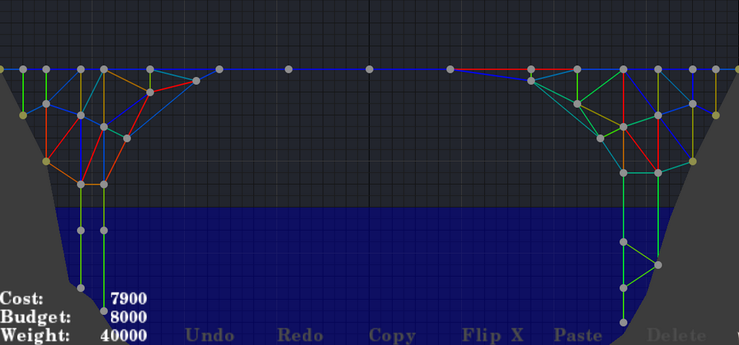
Statics
Ala Bridge Builder
Notes:
As with something like Bridge Builder
Describe bridge builder*
As the train drives over the bridge, we can exactly describe the stresses involved at any instant in time.

Slide 25
Future Work
Notes:
Will now describe limitations and areas for further improvement.

Slide 26
Future Work
Sparseness
Notes:
The O(c^3) decomposition is computationally untenable for most real time applications.
However large collision systems are mostly sparse.
A row in a 1000 collision island might only have a dozen or so non zero elements
*expand*
Newton’s cradle specifically is tridiagonal.
Which can be decomposed in linear time.
More general problems might ideally be decomposed in time only dependant on the number of non zero elements

Slide 27
Future Work
Negative impulses
Notes:
The formulation so far has no discriminated between positive and negative impulses.
In the diagram,
Body B will cause a torque on the See-Saw
Which will cause a negative impulse on Body A.
Lifting Body A above the ground.
This is not correct behavior.
----
We can add non negativity conditions to the impulses.
The problem then is in a form appropriate for Linear Programming

Slide 28
Future Work
Sliding
Notes:
Sliding and friction become problems too.
In the diagram
Body B produces torque on Body A
As it starts sliding down.
This torque eventually becomes 0, then changes sign
As Body B moves from the left to the right of body A.
----
The problem is inherently non-discrete.
One solution would be to solve at discrete moments in time,
and interpolate the results.
Deciding on the proper step size becomes important.
Too coarse and the interpolation is far from correct.
Too fine and we waste a great deal of computational time.

Slide 29
Future Work
Rolling
Notes:
Rolling is especially problematic.
1. As Body B begins its motion, it is rolling.
While rolling, it’s motion is circular.
The exact velocity is determined solely by its angular velocity.
2. Eventually it moves too fast for friction, and it begins sliding as well.
4. Finally, it picks up enough speed to entirely leave the surface of body A.
And will then travel in a ballistic trajectory
--- LAST SLIDE ---
Take questions

